Slide 1
Visualizing High-Dimensional Data with tSNE & UMAP
Ethan, Evan, Electra, and Kara

Slide 2
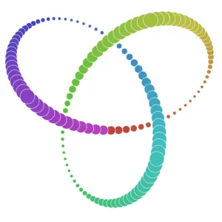

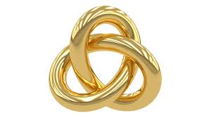
tSNE (t-distributed Stochastic Neighbor Embedding) - Introduction
Like PCA, tSNE is a dimensionality reduction algorithm
Used to visualize high-dimensional data by projecting it into a low dimensional space
tSNE uses nonlinear dimensionality reduction
It is an improvement on SNE and follows the same general algorithm process
Notes:
In SNE:
non-symmetrical - This means that the probability of point xi to consider point xj as its neighbor is not the same probability that point xj would consider point xi as a neighbor
crowding: in correctly projecting close distances between points, the moderate distances are distorted and appear as huge distances in the low dimensional space.
Resolved with student t-test in tSNE, which also results in severe conservation of local structure

Slide 3
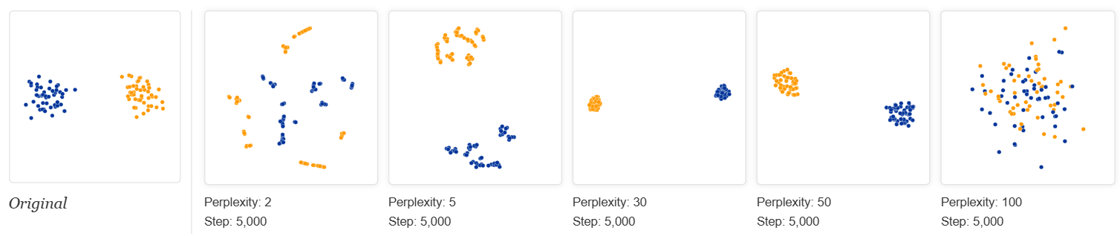
tSNE Hyperparameters
Perplexity: Balance between local and global structure of data
Guesses # of close neighbors to a given point
At low perplexity, local structure dominates
Perplexity should always be less than the number of points
Notes:
Perplexity:# of neighbors each point should have

Slide 4
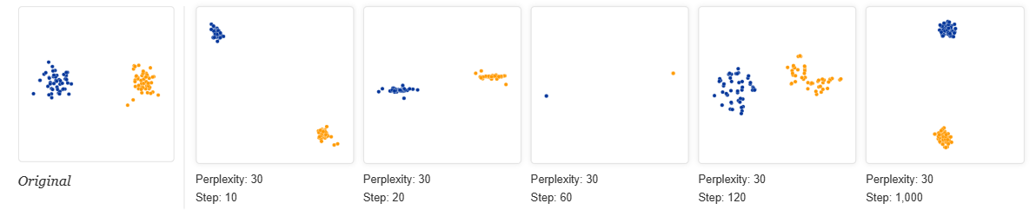
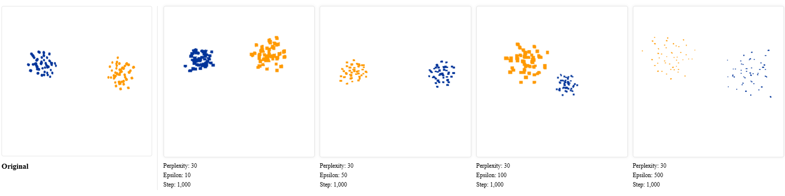
tSNE Hyperparameters
Iterations: # of steps to process data
Want enough iterations to reach stability
Epsilon: Learning Rate
essentially controls the movement of the points in each step
Notes:
tSNE moves every point in the low dimensional graph in every iteration to generate clusters. epsilon (learning rate) controls how much the points move in each iteration. A higher epsilon may require less iterations to reach stability

Slide 5
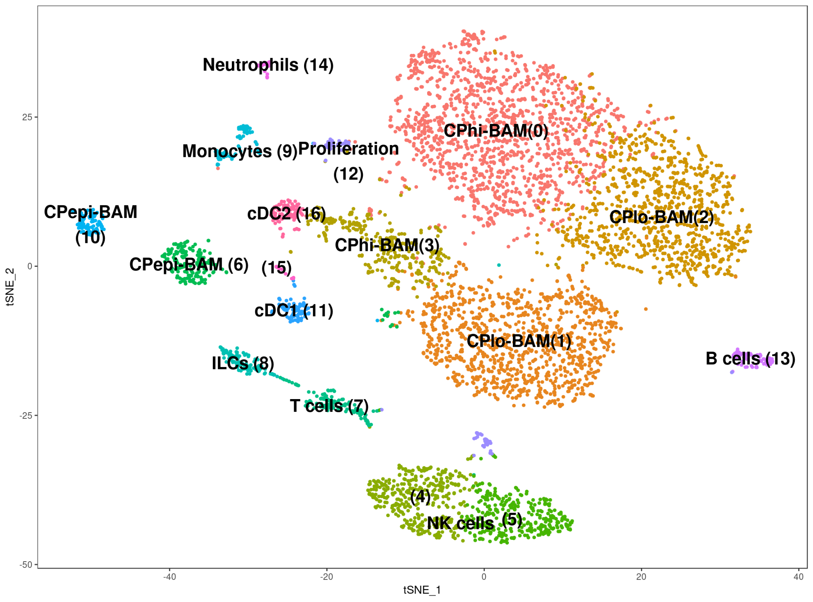
tSNE Graph Interpretation
Every dot is a specific sample (ie, a cell)
Cluster sizes mean nothing
Cannot draw much from distances between clusters, unlike in PCA
tSNE does not place dots farther apart that are very different (poor global structure)
The axes are not directly interpretable
You can make out shapes, generally, in the 2D plotted data
Patterns in a cluster can reveal information about that cluster
Notes:
Cluster size means nothing: original clusters may have different standard deviations (one more closed packed than the other), however, due to prioritization of local structures, it naturally expands denser clusters and condenses sparser ones.
Axes not directly interpretable: No pC1 and PC2
Shapes revealing information: can infer about locally clustered data that a point on one end of the data is more dissimilar from a point on the other end

Slide 6
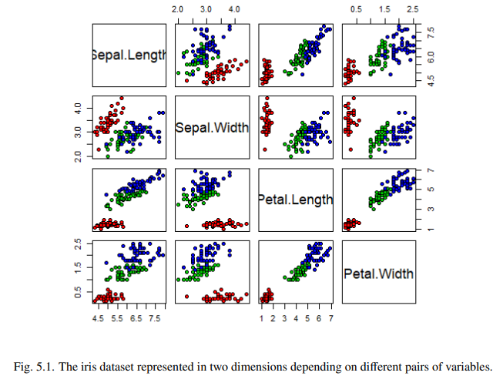
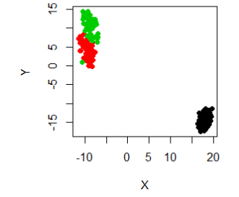
tSNE example - the IRIS flower
50 samples from 3 different species of Iris flowers with 4 different measured variables
We want to know if the features can be used to distinguish between flower species, but it is difficult to analyze all of the graphs separately
tSNE is used to reduce dimensionality and determine if species are separable based on the measured features
Graphs of individually measured features
tSNE result

Slide 7
t-SNE: How it works
Calculates the euclidean distance between points in higher dimensional space

Slide 8
t-SNE: How it works
Calculates the euclidean distance between points in higher dimensional space

Slide 9
t-SNE: How it works
Calculates the euclidean distance between points in higher dimensional space

Slide 10
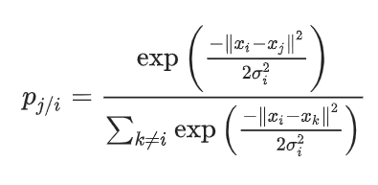
t-SNE: How it works
Converts distances into probabilities using a Gaussian distribution

Slide 11
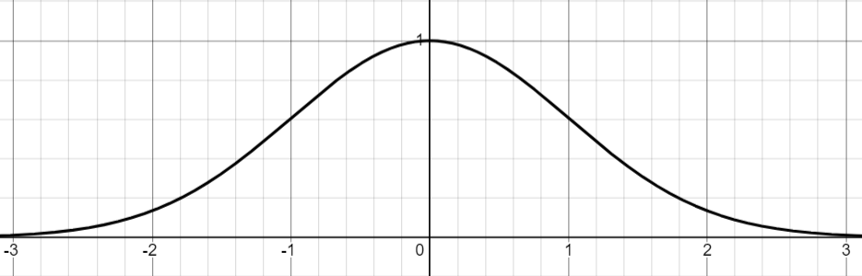
t-SNE: How it works
Converts distances into probabilities using a Gaussian distribution

Slide 12
t-SNE: How it works
Converts distances into probabilities using a Gaussian distribution

Slide 13
t-SNE: How it works
Converts distances into probabilities using a Gaussian distribution
sum of all distance probabilities
Notes:
Probability represents the likelihood of the point of interest choosing another point as a neighbor

Slide 14
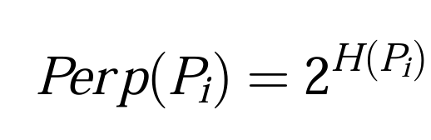
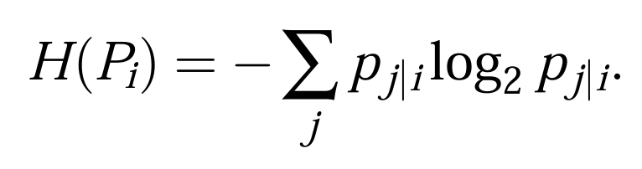
t-SNE: How it works
Variance is set such that the entropy of the distribution is equal to the binary log of the user supplied perplexity
Perplexity essentially determines the largest distance the user considers neighbors
Notes:
uses binary optimization
More spread out points are the higher the entropy

Slide 15
t-SNE: How it works
Variance is set such that the entropy of the distribution is equal to the binary log of the user supplied perplexity
Perplexity essentially determines the largest distance the user considers neighbors
σ² = 1

Slide 16
t-SNE: How it works
Variance is set such that the entropy of the distribution is equal to the binary log of the user supplied perplexity
Perplexity essentially determines the largest distance the user considers neighbors
σ² = 1

Slide 17
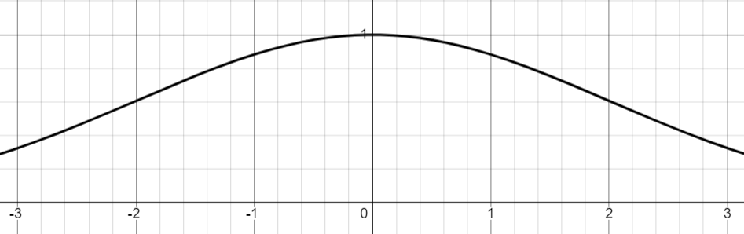
t-SNE: How it works
Variance is set such that the entropy of the distribution is equal to the binary log of the user supplied perplexity
Perplexity essentially determines the largest distance the user considers neighbors
σ² = 4

Slide 18
t-SNE: How it works
Variance is set such that the entropy of the distribution is equal to the binary log of the user supplied perplexity
Perplexity essentially determines the largest distance the user considers neighbors
σ² = 4

Slide 19
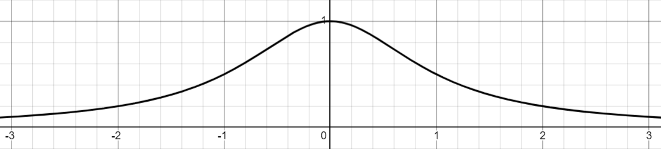
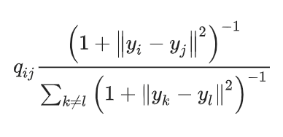

t-SNE: How it works
Converts mapped distances into probabilities using a Student’s t-distribution
sum of all distance probabilities
Notes:
Probability represents the likelihood of the point of interest choosing another point as a neighbor

Slide 20
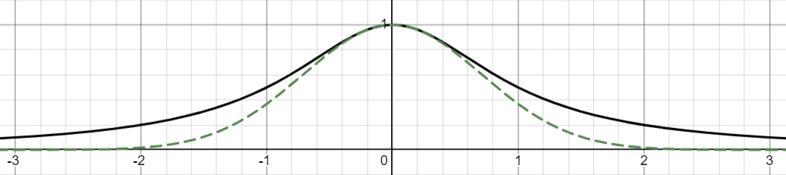
t-SNE: How it works
Converts mapped distances into probabilities using a Student’s t-distribution
sum of all distance probabilities
Notes:
Solves the crowding problem because it drops off slower allowing for more wiggle room

Slide 21
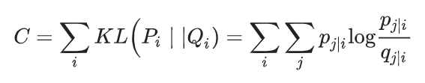
t-SNE: How it works
In low-dimensional space, the positions of the points are mapped so as to optimize the cost function
KL → Kullback-Leibler Divergence
Notes:
Explains the “surprise” from using Q as a model instead of P

Slide 22
t-SNE: How it works
This is done by matching the low-dimensional probability, q_{j|i}, to the high-dimensional probability
=
Notes:
show t distribution vs gaussian to allow for more room to place points
Put in equations

Slide 23
t-SNE: How it works
This is done by matching the low-dimensional probability, q_{j|i}, to the high-dimensional probability
=
Notes:
show t distribution vs gaussian to allow for more room to place points
Put in equations

Slide 24
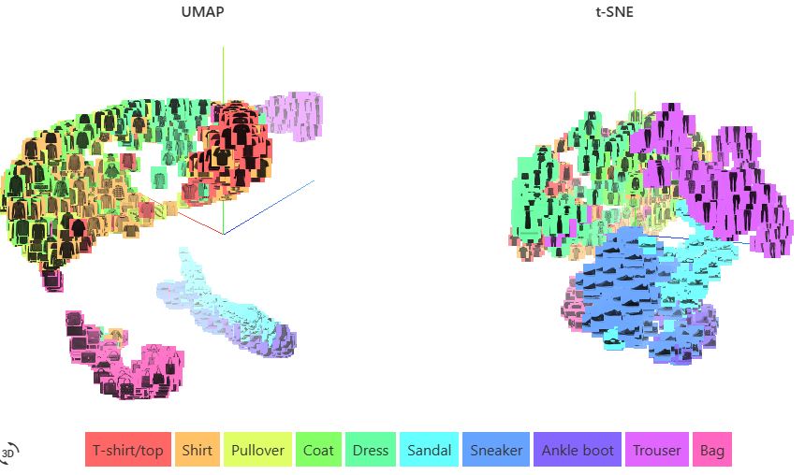
Introduction to UMAP (Uniform Manifold Approximation and Projection)
Also performs dimensionality reduction
Increases speed and preserves the data’s global structure
Algorithmic decisions justified by strong mathematical theory
spectral initialization of low dimensional graph
UMAP more clearly shows similarities and differences between clusters
Notes:
explain KL
show t distribution vs gaussian to allow for more room to place points
Put in equations

Slide 25
UMAP high-dimensional graph and Parameters
UMAP builds a high-dimensional graph called a “fuzzy simplicial complex” before optimizing to a low-dimensional graph
n_neighbors: number of approximate nearest neighbors used to construct the initial high-dimensional graph
Most important parameter, effectively how UMAP balances global vs local structure
min_dist: minimum distance between points in low-dimensional space
Controls how tightly UMAP clumps points together
https://pair-code.github.io/understanding-umap/
Notes:
explain KL
show t distribution vs gaussian to allow for more room to place points
Put in equations

Slide 26
Strengths and Weaknesses: t-SNE
STRENGTHS:
Preserves local structure very well
Good at revealing patterns in data
Non-Linear
WEAKNESSES:
Computationally intensive
Cannot be used for preprocessing (more for visualization than dimensionality reduction)
O(N*log(N))) complexity
Notes:
tSNE Creates a probability distribution over pairs of points in high-dimensional space, and tries to create a similar distribution in low-dimensional space using a t-distribution, which avoids overcrowding.
It’s main benefit is that it is non linear, meaning that it can capture more complex relationships that linear methods, like PCA, wouldn’t be able to capture.
Unlike PCA, tSNE doesn’t preserve global structure as much and is better at visualizing relationships between neighboring points instead of global trends.
“The time complexity for t-SNE is O(N²), and then Barnes Hut SNE is created and published in 2014 to improve time complexity become O(N log N).”

Slide 27
Strengths and Weaknesses: UMAP
STRENGTHS:
Runs very fast (usually faster than tSNE)
More theoretical (mathematical) foundation than tSNE
Good at preserving global structure
Can handle larger datasets well (O(n))
More scalable to large datasets
WEAKNESSES:
High parameter sensitivity
Non directly interpretable distances between points
While more stable than tSNE, it is still stochastic
Residual clusters may be defined that are artifacts of the algorithm
Computationally intensive (< tSNE though)
Less intuitive to newcomers than tSNE
Non Convex Cost Functions
Notes:
UMAP is based on mathematical concepts from topology and manifold theory, and constructs a weighted graph between points in high-dimensional space. It creates a fuzzy topological structure using local connectivity and optimizes the layout in lower dimensions to preserve this structure.
Thus, it does well (especially compared to tSNE) at preserving global structure.
Some limitations, however, are that it is less intuitive than simpler methods like PCA, meaning that there is some introduced room for error for users who are not ML experts.
Branching off of that, UMAP has high parameter sensitivity, meaning that if it is set up incorrectly, it can be very incorrect. This coupled with the complexity/non intuitive nature of it are not great since troubleshooting issues requires a deep understanding/alot of mathematical knowledge.
UMAP (Uniform Manifold Approximation and Projection) has a non-convex cost function. The optimization objective in UMAP combines two terms:
Attractive forces between similar points (trying to keep nearby points close together)
Repulsive forces between dissimilar points (pushing apart points that should be distant)
This combination of attractive and repulsive forces creates a non-convex optimization landscape. The non-convexity means:
Different random initializations can lead to different embeddings
The optimization can get stuck in local minima
The final embedding may depend on the initialization and optimization parameters
This is actually one of the key differences between UMAP and t-SNE - while both are non-convex, UMAP uses a different optimization approach that tends to be more stable and computationally efficient.

Slide 28
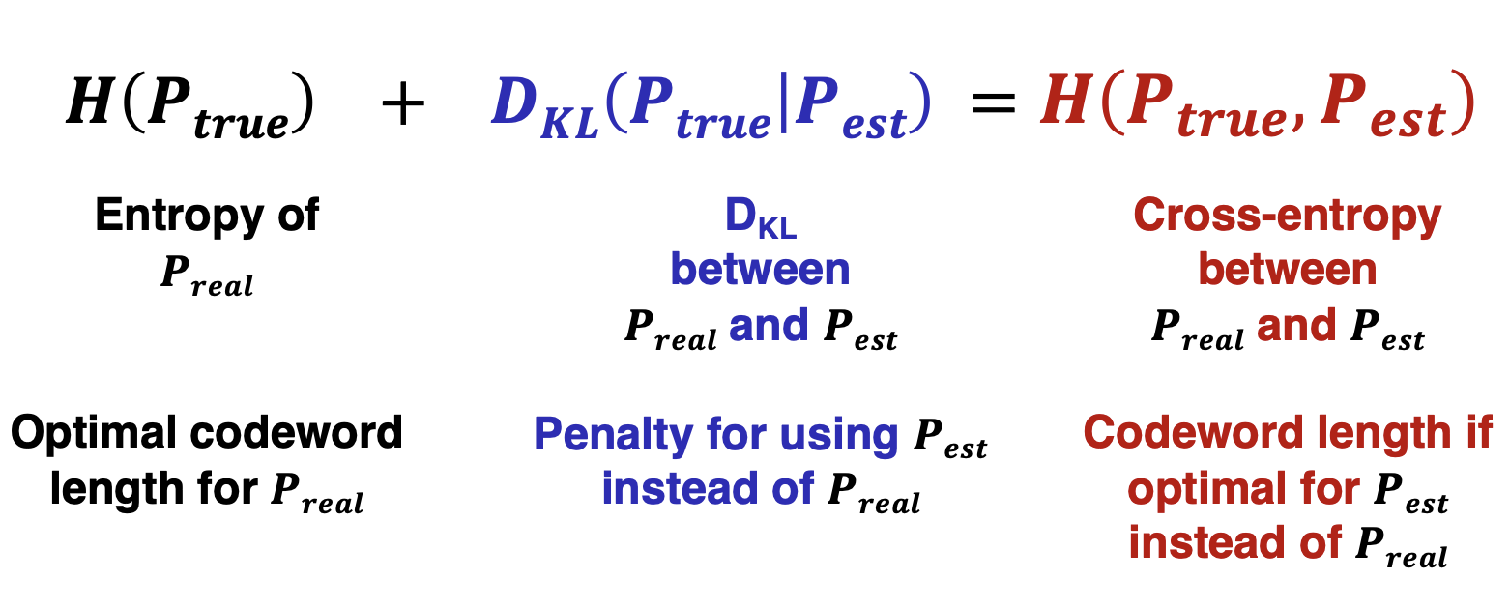
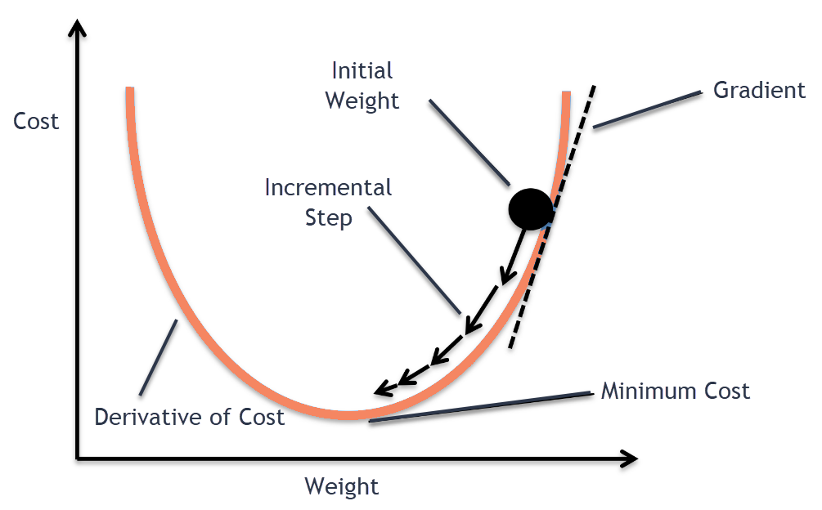
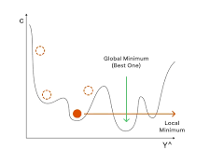
Strengths and Weaknesses: Cost Functions
UMAP uses Cross Entropy while tSNE uses KL-Divergence* (Oskolkov, 2019)
This makes UMAP optimizable with stochastic gradient descent
Galagan, BE 562 Lecture Slides
Notes:
Actually, UMAP also uses cross-entropy but in a different way than traditional KL-divergence used in t-SNE. Let me break this down carefully:
KL-divergence vs Cross-entropy:
Cross-entropy = -∑ p(x) log(q(x))
KL-divergence = ∑ p(x) log(p(x)/q(x)) = -∑ p(x) log(q(x)) + ∑ p(x) log(p(x))
Therefore: KL-divergence = Cross-entropy - Entropy
The key difference is that KL-divergence includes that extra entropy term ∑ p(x) log(p(x)). This means:
Cross-entropy measures the total "surprise" when using distribution q to encode data from distribution p
KL-divergence measures the extra bits needed to encode data from p using q (compared to using p directly)
For t-SNE and UMAP specifically:
t-SNE minimizes KL-divergence between high-dimensional and low-dimensional probability distributions
UMAP minimizes a binary cross-entropy between fuzzy topological representations
The binary cross-entropy in UMAP is specifically: -∑ (v_ij log(w_ij) + (1-v_ij)log(1-w_ij)) where:
v_ij represents high-dimensional similarities
w_ij represents low-dimensional similarities
This binary cross-entropy formulation makes UMAP's objective function more amenable to optimization using stochastic gradient descent, which is one reason it can be faster than t-SNE.

Slide 29
Strengths and Weaknesses: Summary
Metric | tSNE | UMAP
Global structure retention | ok | good
Local structure retention | great | good
Usability for non experts | ok | bad
Preprocessing? | no | yes
Computational intensity | bad (O(n*log(n)) | still bad, but less (O(n))

Slide 30
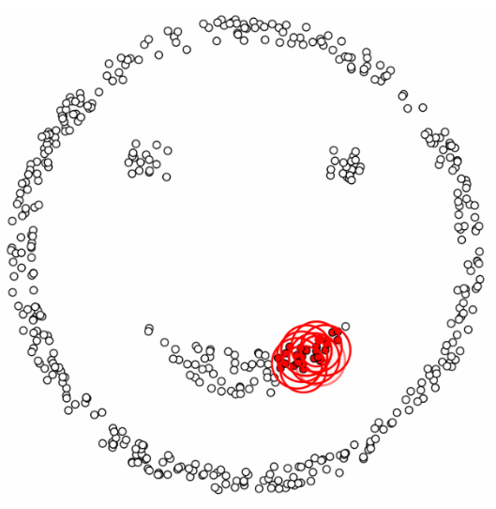
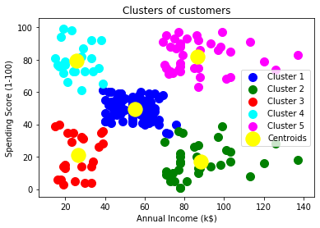
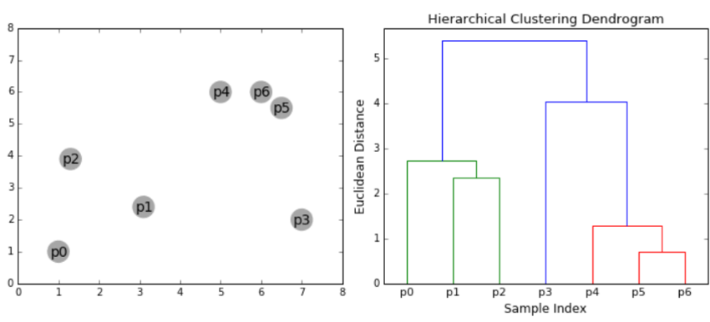
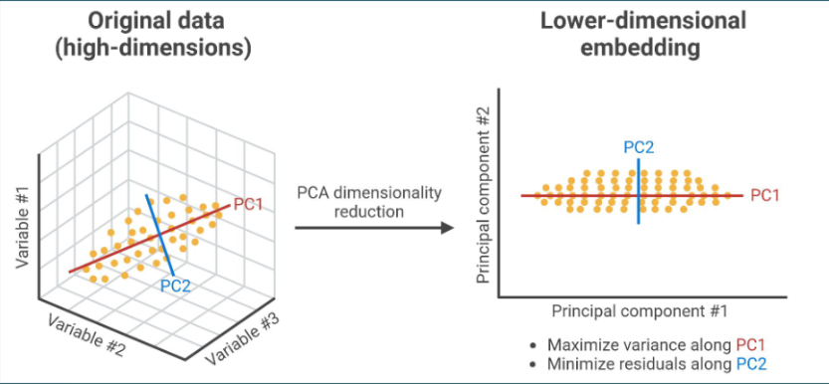
Refresher on Clustering Methods and PCA
https://www.javatpoint.com/k-means-clustering-algorithm-in-machine-learning
Team Margulis
Team Margulis
Team Brenner

Slide 31
Key Differences of t-SNE
 | Clustering | PCA | t-SNE
Dimensionality reduction | no | for visualization and processing | for visualization
Applicable to a new dataset | parameters only | principle components | parameters only
Structure priority | N/A | global | local
Non-linearly separable data | depends | no | yes
Outlier handling | depends | poor | good
Computational strain | depends | relatively low | high for large dataset/high dim.

Slide 32
References
https://distill.pub/2016/misread-tsne/ (helpful for strengths/weaknesses)
https://towardsdatascience.com/t-sne-clearly-explained-d84c537f53a (good for tSNE maths)
https://www.geeksforgeeks.org/difference-between-pca-vs-t-sne/ (PCA vs tSNE)
https://wedadanbtawi95.github.io/tsne/#:~:text=The%20second%20parameter%20in%20t,the%20algorithm%20with%20random%20values.
https://e-archivo.uc3m.es/rest/api/core/bitstreams/ff0eaee9-3736-4854-9529-ac3c45d058ff/content
https://www.scdiscoveries.com/blog/knowledge/how-to-interpret-a-t-sne-plot/ https://medium.com/data-folks-indonesia/the-underlying-idea-of-t-sne-6ce4cff4f7
https://scikit-learn.org/stable/modules/generated/sklearn.manifold.TSNE.html
vandermaaten08a.pdf
https://pair-code.github.io/understanding-umap/
https://www.brainimmuneatlas.org/tsne-cp-irf8.php
t-Distributed Stochastic Neighbor Embedding | SpringerLink
https://towardsdatascience.com/how-exactly-umap-works-13e3040e1668
Kullback–Leibler divergence - Wikipedia

